Slide 1



May 2017
Alison Pask
ANA Health Promotion Manager

Slide 2

Notes:
ANA is pleased to welcome you to day 2 of our 7th Activity & nutrition Aotearoa conference. “Working together Inspiring Change”
When we WORK TOGETHER we have the power to INSPIRE CHANGE; a change that can transform where we live, work, learn and grow into environments that support healthy eating and physical activity.
We believe health promoters, researchers, educators, health professionals, policy makers and the food industry all have the power to INSPIRE CHANGE.
Together we can make a difference

Slide 3
Take home messages
Hayden McRobbie
Professor Jim Mann
Claire Pascoe
and
Sarah Ulmer
Professor Boyd Swinburn
Notes:
I was inspired listening to yesterdays speakers
Hayden McRobbie- Raising Healthy Kids Target, Ministry of Health
Professor Boyd Swinburn, University of Auckland enlightening us on a systems approach to obesity prevention.
Professor Jim Mann from the University of Otago discussed what constitutes evidence for making nutrition recommendations
Claire Pascoe and Sarah Ulmer have inspired more of us to get onto bikes.
At ANA we believe in walking the talk and those of you that stayed for last nights social function will have had a little giggle that we served 100mls of wine per glass.
We were also delighted to assist with fundraising for one of our local schools, Tawa College by giving them a donation to preform at our social function last night. Being creative with school fundraising has been a hot topic for the media in recent weeks.

Slide 4
Activity and Nutrition Aotearoa: ANA
Credible source for research, resources, professional development and news on improving nutrition and increasing physical activity in Aotearoa.
Our purpose is to connect people and organisations engaged in the cause of improving the nation's nutrition and physical activity.
Notes:
In November 2016 Agencies for Nutrition Action was renamed as Activity and Nutrition Aotearoa to better reflect our nutrition and physical activity focus.
Our research shows we are a credible organisation well respected by the sector.
Hosting this conference is one way of achieving our purpose of connecting people & organisations.

Slide 5
A snapshot of the workforce
Notes:
A recent survey of our database has highlighted a possible changing workforce. The question was asked “How much is physical activity and/or nutrition public health the focus of your job?”
You will see from the bottom bar on the slide that only 3% sector have physical activity as the main focus of their job.
Less than a quarter of the workforce state nutrition is the main focus of their job and many of these are working in clinical positions wanting to keep up to date with what's happening in public health
17% of job roles cover both nutrition & Physical activity.
The largest bar at just over 38% shows the majority of our sector have nutrition & PA as part of a greater health promotion role.
At ANA we have noted feedback from the smoke free sector unable to attend the ANA conference today due to activities for world smoke free day.
Being aware of this changing workforce will help ANA to better meet the needs of the Physical activity & nutrition public health workforce in the future.

Slide 6

88 %
Notes:
Hopefully you will be well aware of the ANA website
88 % report the website meets the needs of the nutrition & PA sector. The website contains a wealth of information and is kept up to date with new information added daily.
We are the process of creating an online database. As part of this database you will have the opportunity to enable your details to be shared creating a NZ public health activity & nutrition directory.

Slide 7
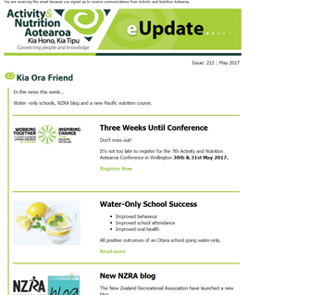
Regular communication
91%
88%
Notes:
Most of you will already receive our fortnightly e Update and our latest survey showed 91% read eUpdate most of the time
88% of the sector who completed the survey said the e update & newsletters provide new knowledge, information on new projects that are useful to the sector
We have listened to your feedback and are working towards creating an even better eUpdate which will arrive in your email inbox fortnightly

Slide 8
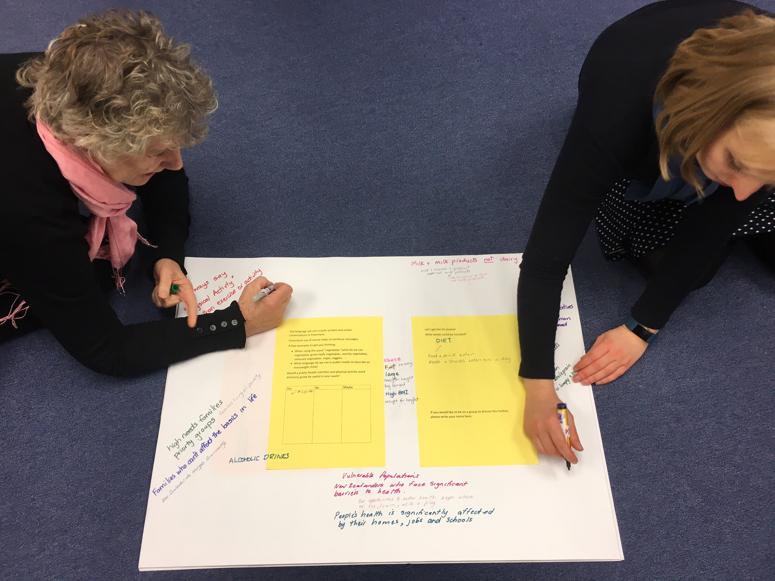
Big Paper
Notes:
The big papers on the tables are another one ANA can obtain your ideas. We welcome your feedback and ask that you take time to add comments to the big pieces of paper on each table.
Each paper explores a different topic and will help to inform ANAs future workplan. When you get a chance wander around the room and add your thoughts. We even have a few spot prizes to give away.

Slide 9
Knowledge Translation
Notes:
ANA is well known for our knowledge translation- that is where we take the research and translate it into plain English. You will find a wealth of information under knowledge translation on our website.
We are currently working on an active transport knowledge translation project with NZ transport Agency.

Slide 10
ANA Regional Forums
Expression of Interest
Notes:
ANA Conference is held every second year with regional forums in-between. Our office has started thinking about what forums could look like. As these events are held in your regions we rely on you to tell us what you need.
If your region would like to host a forum please let me know. I have expression of interest forms with me today and these will also be available on the ANA website shortly.

Slide 11
Thank you for investing your valuable time by attending the 7th ANA conference
Notes:
Over breakfast this morning I enjoyed hearing Carolyn Lister from Plant and food research discussing science to support nutrition and health messages .
I am looking forward to todays key notes speaker professor Fiona Bull from the world health organisation
As its election year I wait in anticipation to hear what our politicians have to say about public health.
Niki Bezzant is our closing conference speaker and she will show us how we can make a difference while working together and inspiring change.
ANA has been in existence for 24 years and in order to stay relevant and deliver activities and resources to better equip and connect the sector we always value hearing from you & look forward to connecting with you in the near future.

